Slide 1
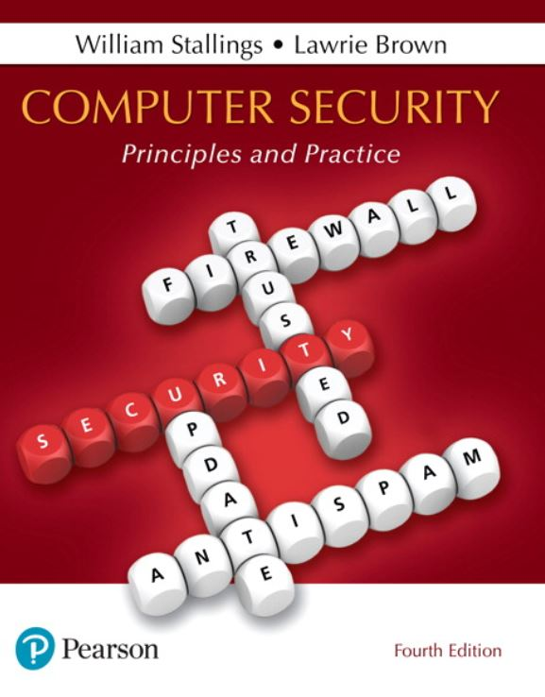
Computer Security: Principles and Practice
Fourth Edition
Chapter 1
Overview
Notes:
If this PowerPoint presentation contains mathematical equations, you may need to check that your computer has the following installed:
1) MathType Plugin
2) Math Player (free versions available)
3) NVDA Reader (free versions available)
This chapter provides an overview of computer security. We begin with a discussion of what we mean by computer security. In essence, computer security deals with computer-related assets that are subject to a variety of threats and for which various measures are taken to protect those assets. Accordingly, the next section of this chapter provides a brief overview of the categories of computer-related assets that users and system managers wish to preserve and protect, and a look at the various threats and attacks that can be made on those assets. Then, we survey the measures that can be taken to deal with such threats and attacks. This we do from three different viewpoints, in Sections 1.3 through 1.5. We then lay out in general terms a computer security strategy.
The focus of this chapter, and indeed this book, is on three fundamental questions:
1. What assets do we need to protect?
2. How are those assets threatened?
3. What can we do to counter those threats?

Slide 2
The N I S T Report N I S T I R 7298 (Glossary of Key Information Security Terms , May 2013) Defines the Term Computer Security as Follows:
“Measures and controls that ensure confidentiality, integrity, and availability of information system assets including hardware, software, firmware, and information being processed, stored, and communicated.”
Notes:
The NIST Internal/Interagency Report NISTIR 7298 (Glossary of Key Information Security Terms , May 2013) defines the term computer security as follows:
Computer Security: Measures and controls that ensure confidentiality, integrity, and availability of information system assets including hardware, software, firmware, and information being processed, stored, and communicated.
This definition introduces three key objectives that are at the heart of computer security:
• Confidentiality: This term covers two related concepts:
— Data confidentiality : Assures that private or confidential information is not made available or disclosed to unauthorized individuals.
— Privacy : Assures that individuals control or influence what information related to them may be collected and stored and by whom and to whom that information may be disclosed.
• Integrity: This term covers two related concepts:
— Data integrity : Assures that information and programs are changed only in a specified and authorized manner.
— System integrity : Assures that a system performs its intended function in an unimpaired manner, free from deliberate or inadvertent unauthorized manipulation of the system.
• Availability: Assures that systems work promptly and service is not denied to authorized users.

Slide 3
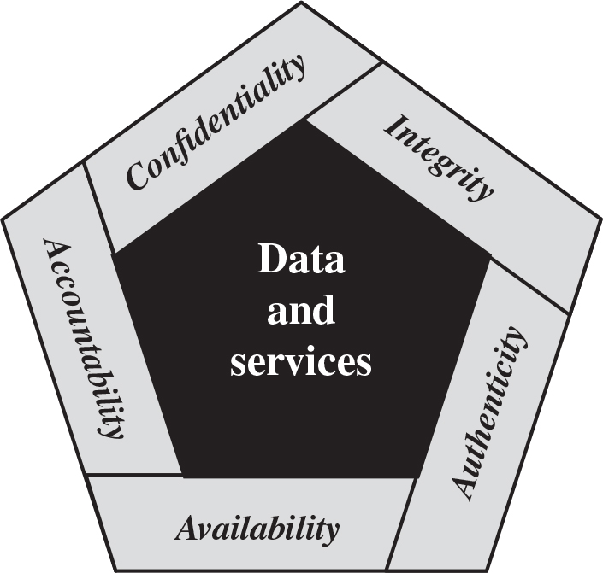
Figure 1.1 Essential Network and Computer Security Objectives
Notes:
These three concepts form what is often referred to as the CIA triad . The three concepts embody the fundamental security objectives for both data and for information and computing services. For example, the NIST standard FIPS 199 (Standards for Security Categorization of Federal Information and Information Systems , February 2004) lists confidentiality, integrity, and availability as the three security objectives for information and for information systems.
Although the use of the CIA triad to define security objectives is well established, some in the security field feel that additional concepts are needed to present a complete picture (see Figure 1.1). Two of the most commonly mentioned are as follows:
• Authenticity: The property of being genuine and being able to be verified and trusted; confidence in the validity of a transmission, a message, or message originator. This means verifying that users are who they say they are and that each input arriving at the system came from a trusted source.
• Accountability: The security goal that generates the requirement for actions of an entity to be traced uniquely to that entity. This supports nonrepudiation, deterrence, fault isolation, intrusion detection and prevention, and after-action recovery and legal action. Because truly secure systems are not yet an achievable goal, we must be able to trace a security breach to a responsible party. Systems must keep records of their activities to permit later forensic analysis to trace security breaches or to aid in transaction disputes.
Note that FIPS 199 includes authenticity under integrity.

Slide 4
Key Security Concepts
Confidentiality
Data confidentiality: Preserving authorized restrictions on information access and disclosure, including means for protecting personal privacy and proprietary information
Privacy : Assures that individuals control or influence what information related to them may be collected and stored and by whom and to whom that information may be disclosed.
Notes:
FIPS 199 provides a useful characterization of these three objectives in terms of requirements and the definition of a loss of security in each category:
• Confidentiality: Preserving authorized restrictions on information access and disclosure, including means for protecting personal privacy and proprietary information. A loss of confidentiality is the unauthorized disclosure of information.
• Integrity: Guarding against improper information modification or destruction, including ensuring information non-repudiation and authenticity. A loss of integrity is the unauthorized modification or destruction of information.
• Availability: Ensuring timely and reliable access to and use of information. A loss of availability is the disruption of access to or use of information or an information system.
Although the use of the CIA triad to define security objectives is well established, some in the security field feel that additional concepts are needed to present a complete picture. Two of the most commonly mentioned are as follows:
• Authenticity: The property of being genuine and being able to be verified and trusted; confidence in the validity of a transmission, a message, or message originator. This means verifying that users are who they say they are and that each input arriving at the system came from a trusted source.
• Accountability: The security goal that generates the requirement for actions of an entity to be traced uniquely to that entity. This supports nonrepudiation, deterrence, fault isolation, intrusion detection and prevention, and after-action recovery and legal action. Because truly secure systems aren’t yet an achievable goal, we must be able to trace a security breach to a responsible party. Systems must keep records of their activities to permit later forensic analysis to trace security breaches or to aid in transaction disputes.
Note that FIPS 199 includes authenticity under integrity.

Slide 5
Key Security Concepts
Integrity
Guarding against improper information modification or destruction, including ensuring information nonrepudiation and authenticity
Data integrity: Assures that information and programs are changed only in a specified and authorized manner.
System integrity: Assures that a system performs its intended function in an unimpaired manner, free from deliberate or inadvertent unauthorized manipulation of the system.
Availability
Ensuring timely and reliable access to and use of information
Notes:
FIPS 199 provides a useful characterization of these three objectives in terms of requirements and the definition of a loss of security in each category:
• Confidentiality: Preserving authorized restrictions on information access and disclosure, including means for protecting personal privacy and proprietary information. A loss of confidentiality is the unauthorized disclosure of information.
• Integrity: Guarding against improper information modification or destruction, including ensuring information non-repudiation and authenticity. A loss of integrity is the unauthorized modification or destruction of information.
• Availability: Ensuring timely and reliable access to and use of information. A loss of availability is the disruption of access to or use of information or an information system.
Although the use of the CIA triad to define security objectives is well established, some in the security field feel that additional concepts are needed to present a complete picture. Two of the most commonly mentioned are as follows:
• Authenticity: The property of being genuine and being able to be verified and trusted; confidence in the validity of a transmission, a message, or message originator. This means verifying that users are who they say they are and that each input arriving at the system came from a trusted source.
• Accountability: The security goal that generates the requirement for actions of an entity to be traced uniquely to that entity. This supports nonrepudiation, deterrence, fault isolation, intrusion detection and prevention, and after-action recovery and legal action. Because truly secure systems aren’t yet an achievable goal, we must be able to trace a security breach to a responsible party. Systems must keep records of their activities to permit later forensic analysis to trace security breaches or to aid in transaction disputes.
Note that FIPS 199 includes authenticity under integrity.

Slide 6
Key Security Concepts
Authenticity
The property of being genuine and being able to be verified and trusted; confidence in the validity of a transmission, a message, or message originator.
This means verifying that users are who they say they are and that each input arriving at the system came from a trusted source.
Notes:
FIPS 199 provides a useful characterization of these three objectives in terms of requirements and the definition of a loss of security in each category:
• Confidentiality: Preserving authorized restrictions on information access and disclosure, including means for protecting personal privacy and proprietary information. A loss of confidentiality is the unauthorized disclosure of information.
• Integrity: Guarding against improper information modification or destruction, including ensuring information non-repudiation and authenticity. A loss of integrity is the unauthorized modification or destruction of information.
• Availability: Ensuring timely and reliable access to and use of information. A loss of availability is the disruption of access to or use of information or an information system.
Although the use of the CIA triad to define security objectives is well established, some in the security field feel that additional concepts are needed to present a complete picture. Two of the most commonly mentioned are as follows:
• Authenticity: The property of being genuine and being able to be verified and trusted; confidence in the validity of a transmission, a message, or message originator. This means verifying that users are who they say they are and that each input arriving at the system came from a trusted source.
• Accountability: The security goal that generates the requirement for actions of an entity to be traced uniquely to that entity. This supports nonrepudiation, deterrence, fault isolation, intrusion detection and prevention, and after-action recovery and legal action. Because truly secure systems aren’t yet an achievable goal, we must be able to trace a security breach to a responsible party. Systems must keep records of their activities to permit later forensic analysis to trace security breaches or to aid in transaction disputes.
Note that FIPS 199 includes authenticity under integrity.

Slide 7
Key Security Concepts
Accountability
The security goal that generates the requirement for actions of an entity to be traced uniquely to that entity.
This supports nonrepudiation, deterrence, fault isolation, intrusion detection and prevention, and after-action recovery and legal action.
Notes:
FIPS 199 provides a useful characterization of these three objectives in terms of requirements and the definition of a loss of security in each category:
• Confidentiality: Preserving authorized restrictions on information access and disclosure, including means for protecting personal privacy and proprietary information. A loss of confidentiality is the unauthorized disclosure of information.
• Integrity: Guarding against improper information modification or destruction, including ensuring information non-repudiation and authenticity. A loss of integrity is the unauthorized modification or destruction of information.
• Availability: Ensuring timely and reliable access to and use of information. A loss of availability is the disruption of access to or use of information or an information system.
Although the use of the CIA triad to define security objectives is well established, some in the security field feel that additional concepts are needed to present a complete picture. Two of the most commonly mentioned are as follows:
• Authenticity: The property of being genuine and being able to be verified and trusted; confidence in the validity of a transmission, a message, or message originator. This means verifying that users are who they say they are and that each input arriving at the system came from a trusted source.
• Accountability: The security goal that generates the requirement for actions of an entity to be traced uniquely to that entity. This supports nonrepudiation, deterrence, fault isolation, intrusion detection and prevention, and after-action recovery and legal action. Because truly secure systems aren’t yet an achievable goal, we must be able to trace a security breach to a responsible party. Systems must keep records of their activities to permit later forensic analysis to trace security breaches or to aid in transaction disputes.
Note that FIPS 199 includes authenticity under integrity.

Slide 8
Levels of Security Breach Impact
Low
The loss could be expected to have a limited adverse effect on organizational operations, organizational assets, or individuals
cause a degradation in mission capability to an extent and duration that the organization is able to perform its primary functions, but the effectiveness of the functions is noticeably reduced;
result in minor damage to organizational assets;
result in minor financial loss; or
result in minor harm to individuals.
Notes:
We use three levels of impact on organizations or individuals should there be a breach of security (i.e., a loss of confidentiality, integrity, or availability). These levels are defined in FIPS 199:
• Low: The loss could be expected to have a limited adverse effect on organizational operations, organizational assets, or individuals. A limited adverse effect means that, for example, the loss of confidentiality, integrity, or availability might (i) cause a degradation in mission capability to an extent and duration that the organization is able to perform its primary functions, but the effectiveness of the functions is noticeably reduced; (ii) result in minor damage to organizational assets; (iii) result in minor financial loss; or (iv) result in minor harm to individuals.
• Moderate: The loss could be expected to have a serious adverse effect on organizational operations, organizational assets, or individuals. A serious adverse effect means that, for example, the loss might (i) cause a significant degradation in mission capability to an extent and duration that the organization is able to perform its primary functions, but the effectiveness of the functions is significantly reduced; (ii) result in significant damage to organizational assets; (iii) result in significant financial loss; or (iv) result in significant harm to individuals that does not involve loss of life or serious, life-threatening injuries.
• High: The loss could be expected to have a severe or catastrophic adverse effect on organizational operations, organizational assets, or individuals. A severe or catastrophic adverse effect means that, for example, the loss might (i) cause a severe degradation in or loss of mission capability to an extent and duration that the organization is not able to perform one or more of its primary functions; (ii) result in major damage to organizational assets; (iii) result in major financial loss; or (iv) result in severe or catastrophic harm to individuals involving loss of life or serious life-threatening injuries.

Slide 9
Levels of Security Breach Impact
Moderate
The loss could be expected to have a serious adverse effect on organizational operations, organizational assets, or individuals
cause a significant degradation in mission capability to an extent and duration that the organization is able to perform its primary functions, but the effectiveness of the functions is significantly reduced;
result in significant damage to organizational assets;
result in significant financial loss; or
result in significant harm to individuals that does not involve loss of life or serious, life-threatening injuries.
Notes:
We use three levels of impact on organizations or individuals should there be a breach of security (i.e., a loss of confidentiality, integrity, or availability). These levels are defined in FIPS 199:
• Low: The loss could be expected to have a limited adverse effect on organizational operations, organizational assets, or individuals. A limited adverse effect means that, for example, the loss of confidentiality, integrity, or availability might (i) cause a degradation in mission capability to an extent and duration that the organization is able to perform its primary functions, but the effectiveness of the functions is noticeably reduced; (ii) result in minor damage to organizational assets; (iii) result in minor financial loss; or (iv) result in minor harm to individuals.
• Moderate: The loss could be expected to have a serious adverse effect on organizational operations, organizational assets, or individuals. A serious adverse effect means that, for example, the loss might (i) cause a significant degradation in mission capability to an extent and duration that the organization is able to perform its primary functions, but the effectiveness of the functions is significantly reduced; (ii) result in significant damage to organizational assets; (iii) result in significant financial loss; or (iv) result in significant harm to individuals that does not involve loss of life or serious, life-threatening injuries.
• High: The loss could be expected to have a severe or catastrophic adverse effect on organizational operations, organizational assets, or individuals. A severe or catastrophic adverse effect means that, for example, the loss might (i) cause a severe degradation in or loss of mission capability to an extent and duration that the organization is not able to perform one or more of its primary functions; (ii) result in major damage to organizational assets; (iii) result in major financial loss; or (iv) result in severe or catastrophic harm to individuals involving loss of life or serious life-threatening injuries.

Slide 10
Levels of Security Breach Impact
High
The loss could be expected to have a severe or catastrophic adverse effect on organizational operations, organizational assets, or individuals
cause a severe degradation in or loss of mission capability to an extent and duration that the organization is not able to perform one or more of its primary functions;
result in major damage to organizational assets;
result in major financial loss; or
result in severe or catastrophic harm to individuals involving loss of life or serious life-threatening injuries.
Notes:
We use three levels of impact on organizations or individuals should there be a breach of security (i.e., a loss of confidentiality, integrity, or availability). These levels are defined in FIPS 199:
• Low: The loss could be expected to have a limited adverse effect on organizational operations, organizational assets, or individuals. A limited adverse effect means that, for example, the loss of confidentiality, integrity, or availability might (i) cause a degradation in mission capability to an extent and duration that the organization is able to perform its primary functions, but the effectiveness of the functions is noticeably reduced; (ii) result in minor damage to organizational assets; (iii) result in minor financial loss; or (iv) result in minor harm to individuals.
• Moderate: The loss could be expected to have a serious adverse effect on organizational operations, organizational assets, or individuals. A serious adverse effect means that, for example, the loss might (i) cause a significant degradation in mission capability to an extent and duration that the organization is able to perform its primary functions, but the effectiveness of the functions is significantly reduced; (ii) result in significant damage to organizational assets; (iii) result in significant financial loss; or (iv) result in significant harm to individuals that does not involve loss of life or serious, life-threatening injuries.
• High: The loss could be expected to have a severe or catastrophic adverse effect on organizational operations, organizational assets, or individuals. A severe or catastrophic adverse effect means that, for example, the loss might (i) cause a severe degradation in or loss of mission capability to an extent and duration that the organization is not able to perform one or more of its primary functions; (ii) result in major damage to organizational assets; (iii) result in major financial loss; or (iv) result in severe or catastrophic harm to individuals involving loss of life or serious life-threatening injuries.

Slide 11
Computer Security Challenges (1 of 2)
Computer security is not as simple as it might first appear to the novice
In developing a particular security mechanism or algorithm, one must always consider potential attacks on those security features
Physical and logical placement needs to be determined
Security mechanisms typically involve more than a particular algorithm or protocol and also require that participants be in possession of some secret information which raises questions about the creation, distribution, and protection of that secret information
Attackers only need to find a single weakness, while the designer must find and eliminate all weaknesses to achieve perfect security
Notes:
Computer security is both fascinating and complex. Some of the reasons follow:
1. Computer security is not as simple as it might first appear to the novice. The requirements seem to be straightforward; indeed, most of the major requirements for security services can be given self-explanatory one-word labels: confidentiality, authentication, nonrepudiation, and integrity. But the mechanisms used to meet those requirements can be quite complex, and understanding them may involve rather subtle reasoning.
2. In developing a particular security mechanism or algorithm, one must always consider potential attacks on those security features. In many cases, successful attacks are designed by looking at the problem in a completely different way, therefore
exploiting an unexpected weakness in the mechanism.
3. Because of Point 2, the procedures used to provide particular services are often counterintuitive. Typically, a security mechanism is complex, and it is not obvious from the statement of a particular requirement that such elaborate measures are
needed. Only when the various aspects of the threat are considered do elaborate security mechanisms make sense.
4. Having designed various security mechanisms, it is necessary to decide where to use them. This is true both in terms of physical placement (e.g., at what points in a network are certain security mechanisms needed) and in a logical sense [e.g.,
at what layer or layers of an architecture such as TCP/IP (Transmission Control Protocol/Internet Protocol) should mechanisms be placed].
5. Security mechanisms typically involve more than a particular algorithm or protocol. They also require that participants be in possession of some secret information (e.g., an encryption key), which raises questions about the creation,
distribution, and protection of that secret information. There may also be a reliance on communications protocols whose behavior may complicate the task of developing the security mechanism. For example, if the proper functioning of the
security mechanism requires setting time limits on the transit time of a message from sender to receiver, then any protocol or network that introduces variable, unpredictable delays may render such time limits meaningless.
6. Computer security is essentially a battle of wits between a perpetrator who tries to find holes, and the designer or administrator who tries to close them. The great advantage that the attacker has is that he or she need only find a single weakness,
while the designer must find and eliminate all weaknesses to achieve perfect security.
7. There is a natural tendency on the part of users and system managers to perceive little benefit from security investment until a security failure occurs.
8. Security requires regular, even constant monitoring, and this is difficult in today’s short-term, overloaded environment.
9. Security is still too often an afterthought to be incorporated into a system after the design is complete, rather than being an integral part of the design process.
10. Many users and even security administrators view strong security as an impediment to efficient and user-friendly operation of an information system or use of information.

Slide 12
Computer Security Challenges (2 of 2)
Security is still too often an afterthought to be incorporated into a system after the design is complete, rather than being an integral part of the design process
Security requires regular and constant monitoring
There is a natural tendency on the part of users and system managers to perceive little benefit from security investment until a security failure occurs
Many users and even security administrators view strong security as an impediment to efficient and user-friendly operation of an information system or use of information

Slide 13
Table 1.1 Computer Security Terminology, from R F C 2828, Internet Security Glossary, May 2000 (1 of 2)
Adversary (threat agent)
Individual, group, organization, or government that conducts or has the intent to conduct detrimental activities.
Attack
Any kind of malicious activity that attempts to collect, disrupt, deny, degrade, or destroy information system resources or the information itself.
Countermeasure
A device or techniques that has as its objective the impairment of the operational effectiveness of undesirable or adversarial activity, or the prevention of espionage, sabotage, theft, or unauthorized access to or use of sensitive information or information systems.
Risk
A measure of the extent to which an entity is threatened by a potential circumstance or event, and typically a function of 1) the adverse impacts that would arise if the circumstance or event occurs; and 2) the likelihood of occurrence.
Notes:
We now introduce some terminology that will be useful throughout the book, relying on RFC 2828, Internet Security Glossary . Table 1.1 defines terms.

Slide 14
Table 1.1 Computer Security Terminology, from R F C 2828, Internet Security Glossary, May 2000 (2 of 2)
Security Policy
A set of criteria for the provision of security services. It defines and constrains the activities of a data processing facility in order to maintain a condition of security for systems and data.
System Resource (Asset)
A major application, general support system, high impact program, physical plant, mission critical system, personnel, equipment, or a logically related group of systems.
Threat
Any circumstance or event with the potential to adversely impact organizational operations (including mission, functions, image, or reputation), organizational assets, individuals, other organizations, or the Nation through an information system via unauthorized access, destruction, disclosure, modification of information, and/or denial of service.
Vulnerability
Weakness in an information system, system security procedures, internal controls, or implementation that could be exploited or triggered by a threat source.

Slide 15
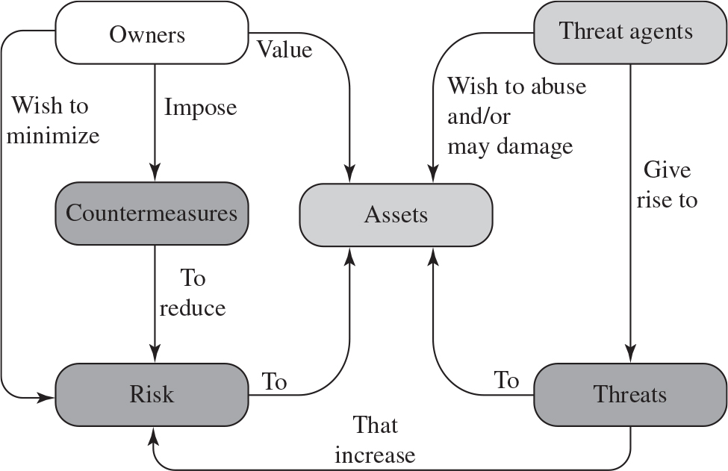
Figure 1.2 Security Concepts and Relationships
Notes:
Figure 1.2, based on [CCPS12a], shows the relationship among some of these terms.
We start with the concept of a system resource , or asset , that users and owners wish to protect.
The diagram is as follows.
1. Owners value assets and wish to minimize risk to assets. The owners impose countermeasures to reduce risk.
2. Threat agents wish to abuse or may damage assets. The agents give rise to threats to assets. The threats increase the risk to assets.

Slide 16
Assets of a Computer System
Hardware
Software
Data
Communication facilities and networks
Notes:
The assets of a computer system can be categorized as follows:
• Hardware: Including computer systems and other data processing, data storage, and data communications devices
• Software: Including the operating system, system utilities, and applications.
• Data: Including files and databases, as well as security-related data, such as password files.
• Communication facilities and networks: Local and wide area network communication links, bridges, routers, and so on.

Slide 17
Vulnerabilities, Threats and Attacks
Categories of vulnerabilities
Corrupted (loss of integrity)
Leaky (loss of confidentiality)
Unavailable or very slow (loss of availability)
Threats
Capable of exploiting vulnerabilities
Represent potential security harm to an asset
Attacks (threats carried out)
Passive – attempt to learn or make use of information from the system that does not affect system resources
Active – attempt to alter system resources or affect their operation
Insider – initiated by an entity inside the security parameter
Outsider – initiated from outside the perimeter
Notes:
In the context of security, our concern is with the vulnerabilities of system resources. [NRC02] lists the following general categories of vulnerabilities of a computer system or network asset:
• The system can be corrupted , so it does the wrong thing or gives wrong answers. For example, stored data values may differ from what they should be because they have been improperly modified.
• The system can become leaky . For example, someone who should not have access to some or all of the information available through the network obtains such access.
• The system can become unavailable or very slow. That is, using the system or network becomes impossible or impractical.
These three general types of vulnerability correspond to the concepts of integrity, confidentiality, and availability, enumerated earlier in this section.
Corresponding to the various types of vulnerabilities to a system resource are threats that are capable of exploiting those vulnerabilities. A threat represents a potential security harm to an asset. An attack is a threat that is carried out (threat action) and, if successful, leads to an undesirable violation of security, or threat consequence. The agent carrying out the attack is referred to as an attacker, or threat agent . We can distinguish two types of attacks:
• Active attack: An attempt to alter system resources or affect their operation.
• Passive attack: An attempt to learn or make use of information from the system that does not affect system resources.
We can also classify attacks based on the origin of the attack:
• Inside attack: Initiated by an entity inside the security perimeter (an “insider”). The insider is authorized to access system resources but uses them in a way not approved by those who granted the authorization.
• Outside attack: Initiated from outside the perimeter, by an unauthorized or illegitimate user of the system (an “outsider”). On the Internet, potential outside attackers range from amateur pranksters to organized criminals, international terrorists, and hostile governments.

Slide 18
Countermeasures
Means used to deal with security attacks
Prevent
Detect
Recover
May itself introduce new vulnerabilities
Residual vulnerabilities may remain
Goal is to minimize residual level of risk to the assets
Notes:
Finally, a countermeasure is any means taken to deal with a security attack. Ideally, a countermeasure can be devised to prevent a particular type of attack from succeeding. When prevention is not possible, or fails in some instance, the goal is to detect the attack and then recover from the effects of the attack. A countermeasure may itself introduce new vulnerabilities. In any case, residual vulnerabilities may remain after the imposition of countermeasures. Such vulnerabilities may be exploited by threat agents representing a residual level of risk to the assets. Owners will seek to minimize that risk given other constraints.

Slide 19
Table 1.2 Threat Consequences, and the Types of Threat Actions That Cause Each Consequence (1 of 2)
Threat Consequence | Threat Action (Attack)
Unauthorized Disclosure A circumstance or event whereby an entity gains access to data for which the entity is not authorized. | Exposure: Sensitive data are directly released to an unauthorized entity. Interception: An unauthorized entity directly accesses sensitive data traveling between authorized sources and destinations. Inference: A threat action whereby an unauthorized entity indirectly accesses sensitive data (but not necessarily the data contained in the communication) by reasoning from characteristics or by-products of communications. Intrusion: An unauthorized entity gains access to sensitive data by circumventing a system’s security protections.
Deception A circumstance or event that may result in an authorized entity receiving false data and believing it to be true. | Masquerade: An unauthorized entity gains access to a system or performs a malicious act by posing as an authorized entity. Falsification: False data deceive an authorized entity. Repudiation: An entity deceives another by falsely denying responsibility for an act.
Notes:
Table 1.2 , based on RFC 4949, describes four kinds of threat consequences and lists the kinds of attacks that result in each consequence.
Unauthorized disclosure is a threat to confidentiality. The following types of attacks can result in this threat consequence:
• Exposure: This can be deliberate, as when an insider intentionally releases sensitive information, such as credit card numbers, to an outsider. It can also be the result of a human, hardware, or software error, which results in an entity gaining unauthorized knowledge of sensitive data. There have been numerous instances of this, such as universities accidentally posting student confidential information on the Web.
• Interception: Interception is a common attack in the context of communications.
On a shared local area network (LAN), such as a wireless LAN or a broadcast Ethernet, any device attached to the LAN can receive a copy of packets intended for another device. On the Internet, a determined hacker can gain access to e-mail traffic and other data transfers. All of these situations create the potential for unauthorized access to data.
• Inference: An example of inference is known as traffic analysis, in which an adversary is able to gain information from observing the pattern of traffic on a network, such as the amount of traffic between particular pairs of hosts on the network. Another example is the inference of detailed information from a database by a user who has only limited access; this is accomplished by repeated queries whose combined results enable inference.
• Intrusion: An example of intrusion is an adversary gaining unauthorized access to sensitive data by overcoming the system’s access control protections.
Deception is a threat to either system integrity or data integrity. The following types of attacks can result in this threat consequence:
• Masquerade: One example of masquerade is an attempt by an unauthorized user to gain access to a system by posing as an authorized user; this could happen if the unauthorized user has learned another user’s logon ID and password. Another example is malicious logic, such as a Trojan horse, that appears to perform a useful or desirable function but actually gains unauthorized access to system resources or tricks a user into executing other malicious logic.
• Falsification: This refers to the altering or replacing of valid data or the introduction of false data into a file or database. For example, a student may alter his or her grades on a school database.
• Repudiation: In this case, a user either denies sending data or a user denies receiving or possessing the data.
Disruption is a threat to availability or system integrity. The following types of attacks can result in this threat consequence:
• Incapacitation: This is an attack on system availability. This could occur as a result of physical destruction of or damage to system hardware. More typically, malicious software, such as Trojan horses, viruses, or worms, could operate in such a way as to disable a system or some of its services.
• Corruption: This is an attack on system integrity. Malicious software in this context could operate in such a way that system resources or services function in an unintended manner. Or a user could gain unauthorized access to a system and modify some of its functions. An example of the latter is a user placing backdoor logic in the system to provide subsequent access to a system and its resources by other than the usual procedure.
Obstruction: One way to obstruct system operation is to interfere with communications by disabling communication links or altering communication control information. Another way is to overload the system by placing excess burden on communication traffic or processing resources.
Usurpation is a threat to system integrity. The following types of attacks can result in this threat consequence:
• Misappropriation: This can include theft of service. An example is a distributed denial of service attack, when malicious software is installed on a number of hosts to be used as platforms to launch traffic at a target host. In this case, the malicious software makes unauthorized use of processor and operating system resources.
• Misuse: Misuse can occur by means of either malicious logic or a hacker that has gained unauthorized access to a system. In either case, security functions can be disabled or thwarted.

Slide 20
Table 1.2 Threat Consequences, and the Types of Threat Actions That Cause Each Consequence (2 of 2)
Threat Consequence | Threat Action (Attack)
Disruption A circumstance or event that interrupts or prevents the correct operation of system services and functions. | Incapacitation: Prevents or interrupts system operation by disabling a system component. Corruption: Undesirably alters system operation by adversely modifying system functions or data. Obstruction: A threat action that interrupts delivery of system services by hindering system operation.
Usurpation A circumstance or event that results in control of system services or functions by an unauthorized entity. | Misappropriation: An entity assumes unauthorized logical or physical control of a system resource. Misuse: Causes a system component to perform a function or service that is detrimental to system security.
Based on R F C 4949

Slide 21
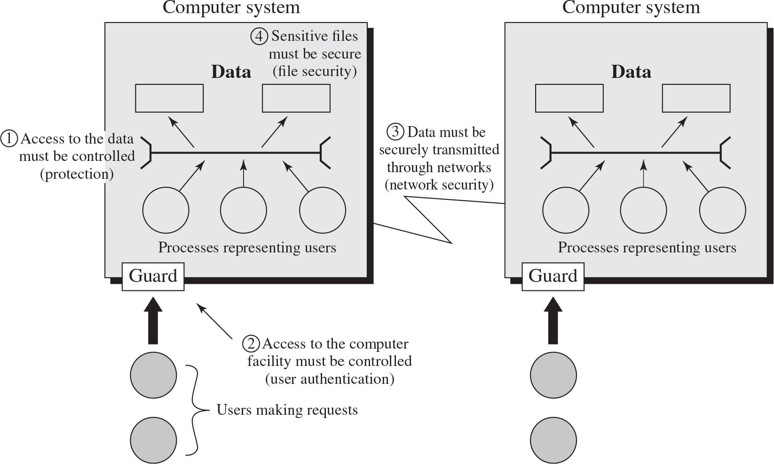
Figure 1.3 Scope of Computer Security
This figure depicts security concerns other than physical security, including control of access to computers systems, safeguarding of data transmitted over communications systems, and safeguarding of stored data.
Notes:
The assets of a computer system can be categorized as hardware, software, data, and communication lines and networks. In this subsection, we briefly describe these four categories and relate these to the concepts of integrity, confidentiality, and availability introduced in Section 1.1 (see Figure 1.3 and Table 1.3 ).
A computer system with data and processes representing users. Users make requests to the computer which moves through the guard on the system. 1. Access to the data must be controlled, protection. 2. Access to the computer facility must be controlled, user authentication. 3. The data must be securely transmitted through networks, network security. 4. Sensitive files must be secure, file security.

Slide 22
Table 1.3 Computer and Network Assets, with Examples of Threats
Blank | Availability | Confidentiality | Integrity
Hardware | Equipment is stolen or disabled, thus denying service. | An unencrypted U S B drive is stolen. | Blank
Software | Programs are deleted, denying access to users. | An unauthorized copy of software is made. | A working program is modified, either to cause it to fail during execution or to cause it to do some unintended task.
Data | Files are deleted, denying access to users. | An unauthorized read of data is performed. An analysis of statistical data reveals underlying data. | Existing files are modified or new files are fabricated.
Communication Lines and Networks | Messages are destroyed or deleted. Communication lines or networks are rendered unavailable. | Messages are read. The traffic pattern of messages is observed. | Messages are modified, delayed, reordered, or duplicated. False messages are fabricated.
Notes:
HARDWARE A major threat to computer system hardware is the threat to availability. Hardware is the most vulnerable to attack and the least susceptible to automated controls. Threats include accidental and deliberate damage to equipment as well as theft. The proliferation of personal computers and workstations and the widespread use of LANs increase the potential for losses in this area. Theft of USB drives can lead to loss of confidentiality. Physical and administrative security measures are needed to deal with these threats.
SOFTWARE Software includes the operating system, utilities, and application programs. A key threat to software is an attack on availability. Software, especially application software, is often easy to delete. Software can also be altered or damaged to render it useless. Careful software configuration management, which includes making backups of the most recent version of software, can maintain high availability. A more difficult problem to deal with is software modification that results in a program that still functions but that behaves differently than before, which is a threat to integrity/authenticity. Computer viruses and related attacks fall into this category. A final problem is protection against software piracy. Although certain countermeasures are available, by and large the problem of unauthorized copying of software has not been solved.
DATA Hardware and software security are typically concerns of computing center professionals or individual concerns of personal computer users. A much more widespread problem is data security, which involves files and other forms of data controlled by individuals, groups, and business organizations.
Security concerns with respect to data are broad, encompassing availability, secrecy, and integrity. In the case of availability, the concern is with the destruction of data files, which can occur either accidentally or maliciously.
The obvious concern with secrecy is the unauthorized reading of data files or databases, and this area has been the subject of perhaps more research and effort than any other area of computer security. A less obvious threat to secrecy involves the analysis of data and manifests itself in the use of so-called statistical databases, which provide summary or aggregate information. Presumably, the existence of aggregate information does not threaten the privacy of the individuals involved. However, as the use of statistical databases grows, there is an increasing potential for disclosure of personal information. In essence, characteristics of constituent individuals may be identified through careful analysis. For example, if one table records the aggregate of the incomes of respondents A, B, C, and D and another records the aggregate of the incomes of A, B, C, D, and E, the difference between the two aggregates would be the income of E. This problem is exacerbated by the
increasing desire to combine data sets. In many cases, matching several sets of data for consistency at different levels of aggregation requires access to individual units. Thus, the individual units, which are the subject of privacy concerns, are available at various stages in the processing of data sets.
Finally, data integrity is a major concern in most installations. Modifications to data files can have consequences ranging from minor to disastrous.

Slide 23
Passive and Active Attacks
Passive Attack
Attempts to learn or make use of information from the system but does not affect system resources
Eavesdropping on, or monitoring of, transmissions
Goal of attacker is to obtain information that is being transmitted
Two types:
Release of message contents
Traffic analysis
Active Attack
Attempts to alter system resources or affect their operation
Involve some modification of the data stream or the creation of a false stream
Four categories:
Replay
Masquerade
Modification of messages
Denial of service
Notes:
Network security attacks can be classified as passive attacks and active attacks . A passive attack attempts to learn or make use of information from the system but does not affect system resources. An active attack attempts to alter system resources or affect their operation.
Passive attacks are in the nature of eavesdropping on, or monitoring of, transmissions. The goal of the attacker is to obtain information that is being transmitted. Two types of passive attacks are release of message contents and traffic analysis.
The release of message contents is easily understood. A telephone conversation, an electronic mail message, and a transferred file may contain sensitive or confidential information. We would like to prevent an opponent from learning the contents of these transmissions.
A second type of passive attack, traffic analysis , is subtler. Suppose that we had a way of masking the contents of messages or other information traffic so that opponents, even if they captured the message, could not extract the information from the message. The common technique for masking contents is encryption. If we had encryption protection in place, an opponent might still be able to observe the pattern of these messages. The opponent could determine the location and identity of communicating hosts and could observe the frequency and length of messages being exchanged. This information might be useful in guessing the nature of the communication that was taking place.
Passive attacks are very difficult to detect because they do not involve any alteration of the data. Typically, the message traffic is sent and received in an apparently normal fashion and neither the sender nor receiver is aware that a third party has read the messages or observed the traffic pattern. However, it is feasible to prevent the success of these attacks, usually by means of encryption. Thus, the emphasis in dealing with passive attacks is on prevention rather than detection.
Active attacks involve some modification of the data stream or the creation of a false stream and can be subdivided into four categories: replay, masquerade, modification of messages, and denial of service.
Replay involves the passive capture of a data unit and its subsequent retransmission to produce an unauthorized effect.
A masquerade takes place when one entity pretends to be a different entity. A masquerade attack usually includes one of the other forms of active attack. For example, authentication sequences can be captured and replayed after a valid authentication sequence has taken place, thus enabling an authorized entity with few privileges to obtain extra privileges by impersonating an entity that has those privileges.
Modification of messages simply means that some portion of a legitimate message is altered, or that messages are delayed or reordered, to produce an unauthorized effect. For example, a message stating, “Allow John Smith to read confidential file accounts” is modified to say, “Allow Fred Brown to read confidential file accounts.”
The denial of service prevents or inhibits the normal use or management of communications facilities. This attack may have a specific target; for example, an entity may suppress all messages directed to a particular destination (e.g., the security audit service). Another form of service denial is the disruption of an entire network, either by disabling the network or by overloading it with messages so as to degrade performance.
Active attacks present the opposite characteristics of passive attacks. Whereas passive attacks are difficult to detect, measures are available to prevent their success. On the other hand, it is quite difficult to prevent active attacks absolutely, because to do so would require physical protection of all communications facilities and paths at all times. Instead, the goal is to detect them and to recover from any disruption or delays caused by them. Because the detection has a deterrent effect, it may also contribute to prevention.

Slide 24
Table 1.4 Security Requirements (1 of 7)
Access Control: Limit information system access to authorized users, processes acting on behalf of authorized users, or devices (including other information systems) and to the types of transactions and functions that authorized users are permitted to exercise.
Awareness and Training:
Ensure that managers and users of organizational information systems are made aware of the security risks associated with their activities and of the applicable laws, regulations, and policies related to the security of organizational information systems; and
ensure that personnel are adequately trained to carry out their assigned information security-related duties and responsibilities.
Audit and Accountability:
Create, protect, and retain information system audit records to the extent needed to enable the monitoring, analysis, investigation, and reporting of unlawful, unauthorized, or inappropriate information system activity; and
ensure that the actions of individual information system users can be uniquely traced to those users so they can be held accountable for their actions.
Notes:
There are a number of ways of classifying and characterizing the countermeasures that may be used to reduce vulnerabilities and deal with threats to system assets. It will be useful for the presentation in the remainder of the book to look at several approaches, which we do in this and the next two sections. In this section, we view countermeasures in terms of functional requirements, and we follow the classification defined in FIPS 200 ( Minimum Security Requirements for Federal Information and Information Systems ). This standard enumerates 17 security-related areas with regard to protecting the confidentiality, integrity, and availability of information systems and the information processed, stored, and transmitted by those systems.
The areas are defined in Table 1.4.
The requirements listed in FIP 200 encompass a wide range of countermeasures to security vulnerabilities and threats. Roughly, we can divide these countermeasures into two categories: those that require computer security technical measures (covered in this book in Parts One and Two), either hardware or software, or both; and those that are fundamentally management issues (covered in Part Three).

Slide 25
Table 1.4 Security Requirements (2 of 7)
Certification, Accreditation, and Security Assessments:
Periodically assess the security controls in organizational information systems to determine if the controls are effective in their application;
develop and implement plans of action designed to correct deficiencies and reduce or eliminate vulnerabilities in organizational information systems;
authorize the operation of organizational information systems and any associated information system connections; and
monitor information system security controls on an ongoing basis to ensure the continued effectiveness of the controls.
Configuration Management:
Establish and maintain baseline configurations and inventories of organizational information systems (including hardware, software, firmware, and documentation) throughout the respective system development life cycles; and
establish and enforce security configuration settings for information technology products employed in organizational information systems.

Slide 26
Table 1.4 Security Requirements (3 of 7)
Contingency Planning: Establish, maintain, and implement plans for emergency response, backup operations, and postdisaster recovery for organizational information systems to ensure the availability of critical information resources and continuity of operations in emergency situations.
Identification and Authentication: Identify information system users, processes acting on behalf of users, or devices, and authenticate (or verify) the identities of those users, processes, or devices, as a prerequisite to allowing access to organizational information systems.
Incident Response:
Establish an operational incident-handling capability for organizational information systems that includes adequate preparation, detection, analysis, containment, recovery, and user-response activities; and
track, document, and report incidents to appropriate organizational officials and/or authorities.

Slide 27
Table 1.4 Security Requirements (4 of 7)
Maintenance:
Perform periodic and timely maintenance on organizational information systems; and
provide effective controls on the tools, techniques, mechanisms, and personnel used to conduct information system maintenance.
Media Protection:
Protect information system media, both paper and digital;
limit access to information on information system media to authorized users; and
sanitize or destroy information system media before disposal or release for reuse.
Physical and Environmental Protection:
Limit physical access to information systems, equipment, and the respective operating environments to authorized individuals;
protect the physical plant and support infrastructure for information systems;
provide supporting utilities for information systems;
protect information systems against environmental hazards; and
provide appropriate environmental controls in facilities containing information systems.
Notes:
Each of the functional areas may involve both computer security technical measures and management measures. Functional areas that primarily require computer security technical measures include access control, identification and authentication, system and communication protection, and system and information integrity. Functional areas that primarily involve management controls and procedures include awareness and training; audit and accountability; certification, accreditation, and security assessments; contingency planning; maintenance; physical and environmental protection; planning; personnel security; risk assessment; and systems and services acquisition. Functional areas that overlap computer security technical measures and management controls include configuration management, incident response, and media protection.
Note the majority of the functional requirements areas in FIPS 200 are either primarily issues of management or at least have a significant management component, as opposed to purely software or hardware solutions. This may be new to some readers, and is not reflected in many of the books on computer and information security. But as one computer security expert observed, “If you think technology can solve your security problems, then you don’t understand the problems and you don’t understand the technology” [SCHN00]. This book reflects the need to combine technical and managerial approaches to achieve effective computer security.
FIPS 200 provides a useful summary of the principal areas of concern, both technical and managerial, with respect to computer security. This book attempts to cover all of these areas.

Slide 28
Table 1.4 Security Requirements (5 of 7)
Planning: Develop, document, periodically update, and implement security plans for organizational information systems that describe the security controls in place or planned for the information systems and the rules of behavior for individuals accessing the information systems.
Personnel Security:
Ensure that individuals occupying positions of responsibility within organizations (including third-party service providers) are trustworthy and meet established security criteria for those positions;
ensure that organizational information and information systems are protected during and after personnel actions such as terminations and transfers; and
employ formal sanctions for personnel failing to comply with organizational security policies and procedures.
Risk Assessment: Periodically assess the risk to organizational operations (including mission, functions, image, or reputation), organizational assets, and individuals, resulting from the operation of organizational information systems and the associated processing, storage, or transmission of organizational information.

Slide 29
Table 1.4 Security Requirements (6 of 7)
Systems and Services Acquisition:
Allocate sufficient resources to adequately protect organizational information systems;
employ system development life cycle processes that incorporate information security considerations;
employ software usage and installation restrictions; and
ensure that third-party providers employ adequate security measures to protect information, applications, and/or services outsourced from the organization.
System and Communications Protection:
Monitor, control, and protect organizational communications (i.e., information transmitted or received by organizational information systems) at the external boundaries and key internal boundaries of the information systems; and
employ architectural designs, software development techniques, and systems engineering principles that promote effective information security within organizational information systems.

Slide 30
Table 1.4 Security Requirements (7 of 7)
System and Information Integrity:
Identify, report, and correct information and information system flaws in a timely manner;
provide protection from malicious code at appropriate locations within organizational information systems; and
monitor information system security alerts and advisories and take appropriate actions in response.
(F I P S 200)

Slide 31
Fundamental Security Design Principles
Economy of mechanism
Fail-safe defaults
Complete mediation
Open design
Separation of privilege
Least privilege
Least common mechanism
Psychological acceptability
Isolation
Encapsulation
Modularity
Layering
Least astonishment
Notes:
Despite years of research and development, it has not been possible to develop security design and implementation techniques that systematically exclude security flaws and prevent all unauthorized actions. In the absence of such foolproof techniques, it is useful to have a set of widely agreed design principles that can guide the development of protection mechanisms. The National Centers of Academic Excellence in Information Assurance/Cyber Defense, which is jointly sponsored by the U.S. National Security Agency and the U. S. Department of Homeland Security, list the following as fundamental security design principles [NCAE13]:
• Economy of mechanism
• Fail-safe defaults
• Complete mediation
• Open design
• Separation of privilege
• Least privilege
• Least common mechanism
• Psychological acceptability
• Isolation
• Encapsulation
• Modularity
• Layering
• Least astonishment
The first eight listed principles were first proposed in [SALT75] and have withstood the test of time.

Slide 32
Attack Surfaces
Consist of the reachable and exploitable vulnerabilities in a system
Examples:
Open ports on outward facing Web and other servers, and code listening on those ports
Services available on the inside of a firewall
Code that processes incoming data, email, X M L, office documents, and industry-specific custom data exchange formats
Interfaces, S Q L, and Web forms
An employee with access to sensitive information vulnerable to a social engineering attack
Notes:
An attack surface consists of the reachable and exploitable vulnerabilities in a system [BELL16, MANA11, HOWA03]. Examples of attack surfaces are the following:
• Open ports on outward facing Web and other servers, and code listening on those ports
• Services available on the inside of a firewall
• Code that processes incoming data, email, XML, office documents, and industry-specific custom data exchange formats
• Interfaces, SQL, and Web forms
• An employee with access to sensitive information vulnerable to a social engineering attack

Slide 33
Attack Surface Categories
Network Attack Surface
Vulnerabilities over an enterprise network, wide-area network, or the Internet
Included in this category are network protocol vulnerabilities, such as those used for a denial-of-service attack, disruption of communications links, and various forms of intruder attacks
Software Attack Surface
Vulnerabilities in application, utility, or operating system code
Particular focus is Web server software
Human Attack Surface
Vulnerabilities created by personnel or outsiders, such as social engineering, human error, and trusted insiders
Notes:
Attack surfaces can be categorized in the following way:
• Network attack surface: This category refers to vulnerabilities over an enterprise network, wide-area network, or the Internet. Included in this category are network protocol vulnerabilities, such as those used for a denial-of-service attack, disruption of communications links, and various forms of intruder attacks.
• Software attack surface: This refers to vulnerabilities in application, utility, or operating system code. A particular focus in this category is Web server software.
• Human attack surface: This category refers to vulnerabilities created by personnel or outsiders, such as social engineering, human error, and trusted insiders.
An attack surface analysis is a useful technique for assessing the scale and severity of threats to a system. A systematic analysis of points of vulnerability makes developers and security analysts aware of where security mechanisms are required. Once an attack surface is defined, designers may be able to find ways to make the surface smaller, thus making the task of the adversary more difficult. The attack surface also provides guidance on setting priorities for testing, strengthening security measures, or modifying the service or application.

Slide 34
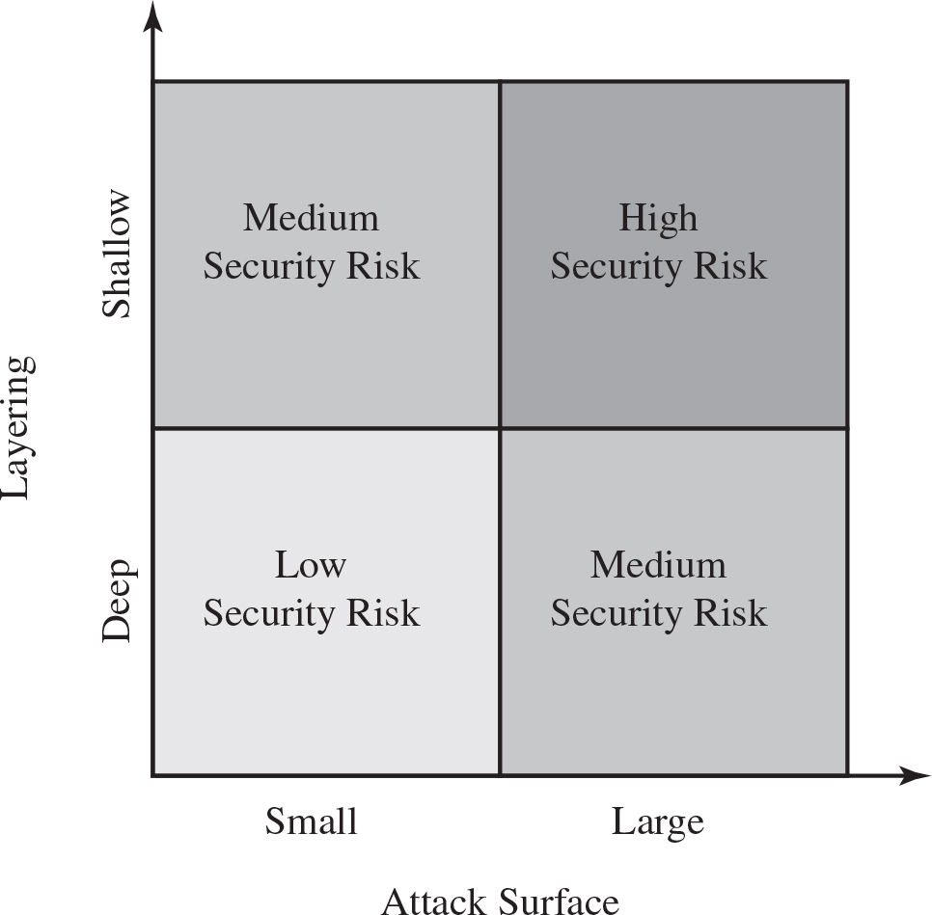
Figure 1.4 Defense in Depth and Attack Surface
Notes:
As illustrated in Figure 1.4, the use of layering, or defense in depth, and attack surface reduction complement each other in mitigating security risk.
The data listed are as follows.
A table has 2 rows and 3 columns. The columns have the following headings from left to right. Description, Attack surface, small, Attack surface, large,. The row entries are as follows. Row 1. Description, Layering, deep. Attack surface, small, Medium security risk. Attack surface, large, High security risk. Row 2. Description, Layering, shallow. Attack surface, small, low security risk. Attack surface, large, medium security risk.

Slide 35
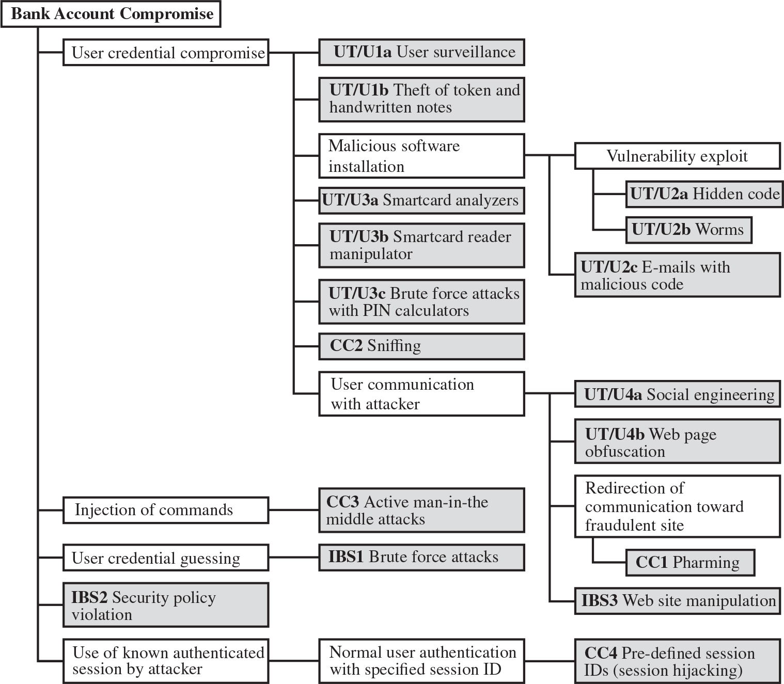
Figure 1.5 An Attack Tree for Internet Banking Authentication
Notes:
An attack tree is a branching, hierarchical data structure that represents a set of potential techniques for exploiting security vulnerabilities [MAUW05, MOOR01, SCHN99]. The security incident that is the goal of the attack is represented as the root node of the tree, and the ways that an attacker could reach that goal are iteratively and incrementally represented as branches and subnodes of the tree. Each subnode defines a subgoal, and each subgoal may have its own set of further subgoals, etc. The final nodes on the paths outward from the root, i.e., the leaf nodes, represent different ways to initiate an attack. Each node other than a leaf is either an AND-node or an OR-node. To achieve the goal represented by an AND-node, the subgoals represented by all of that node’s subnodes must be achieved; and for an OR-node, at least one of the subgoals must be achieved. Branches can be labeled with values representing difficulty, cost, or other attack attributes, so that alternative attacks can be compared.
The motivation for the use of attack trees is to effectively exploit the information available on attack patterns. Organizations such as CERT publish security advisories that have enabled the development of a body of knowledge about both general attack strategies and specific attack patterns. Security analysts can use the attack tree to document security attacks in a structured form that reveals key vulnerabilities. The attack tree can guide both the design of systems and applications, and the choice and strength of countermeasures.
Figure 1.5, based on a figure in [DIMI07], is an example of an attack tree analysis for an Internet banking authentication application. The root of the tree is the objective of the attacker, which is to compromise a user’s account. The shaded boxes on the tree are the leaf nodes, which represent events that comprise the attacks. The white boxes are categories which consist of one or more specific attack events (leaf nodes). Note that in this tree, all the nodes other than leaf nodes are OR-nodes. The analysis used to generate this tree considered the three components involved in authentication:
• User terminal and user (UT/U): These attacks target the user equipment, including the tokens that may be involved, such as smartcards or other password generators, as well as the actions of the user.
• Communications channel (CC): This type of attack focuses on communication links.
• Internet banking server (IBS): These types of attacks are offline attack against the servers that host the Internet banking application.
Five overall attack strategies can be identified, each of which exploits one or more of the three components. The five strategies are as follows:
• User credential compromise: This strategy can be used against many elements of the attack surface. There are procedural attacks, such as monitoring a user’s action to observe a PIN or other credential, or theft of the user’s token or handwritten notes. An adversary may also compromise token information using a variety of token attack tools, such as hacking the smartcard or using a brute force approach to guess the PIN. Another possible strategy is to embed malicious software to compromise the user’s login and password. An adversary may also attempt to obtain credential information via the communication channel (sniffing). Finally, an adversary may use various means to engage in communication with the target user, as shown in Figure 1.5.
• Injection of commands: In this type of attack, the attacker is able to intercept communication between the UT and the IBS. Various schemes can be used to be able to impersonate the valid user and so gain access to the banking system.
• User credential guessing: It is reported in [HILT06] that brute force attacks against some banking authentication schemes are feasible by sending random usernames and passwords. The attack mechanism is based on distributed zombie personal computers, hosting automated programs for username- or password-based calculation.
• Security policy violation: For example, violating the bank’s security policy in combination with weak access control and logging mechanisms, an employee may cause an internal security incident and expose a customer’s account.
• Use of known authenticated session: This type of attack persuades or forces the user to connect to the IBS with a preset session ID. Once the user authenticates to the server, the attacker may utilize the known session ID to send packets to the IBS, spoofing the user’s identity.
Figure 1.5 provides a thorough view of the different types of attacks on an Internet banking authentication application. Using this tree as a starting point, security analysts can assess the risk of each attack and, using the design principles outlined in the preceding section, design a comprehensive security facility. [DIMO07] provides a good account of the results of this design effort.
The diagram is as follows.
Bank account compromise
1. User credential compromise
U T slash U 1 a user surveillance
U T slash U 1 b theft of token and handwritten notes
Malicious software installation. Vulnerability exploit, U T slash U 2 a hidden code, U T slash U 2 b worms. U T slash U 2 x emails with malicious code
U T slash U 3 a smartcard analyzers
U T slash U 3 b smartcard reader manipulator
U T slash U 3 c brute force attacks with P I N calculators
C C 2 sniffing
User communication with attacker. U T slash U 4 a social engineering. U T slash web page obfuscation. Redirection of communication toward fraudulent site, C C 1 pharming. I B S 3 website manipulation
2.2. Injection of commands, C C 3 active man in the idle attacks
3. User credential guessing, I B S 1 brute force attacks
4. I B S 2 security policy violation
5. Use of known authenticated session by attacker. Normal user authentication with specified session I D, C C 4 predefined session I Ds, session hijacking

Slide 36
Computer Security Strategy (1 of 2)
Security Policy
Formal statement of rules and practices that specify or regulate how a system or organization provides security services to protect sensitive and critical system resources
Security Implementation
Involves four complementary courses of action:
Prevention
Detection
Response
Recovery
Notes:
The first step in devising security services and mechanisms is to develop a security policy. Those involved with computer security use the term security policy in various ways. At the least, a security policy is an informal description of desired system behavior [NRC91]. Such informal policies may reference requirements for security, integrity, and availability. More usefully, a security policy is a formal statement of rules and practices that specify or regulate how a system or organization provides security services to protect sensitive and critical system resources (RFC 4949). Such a formal security policy lends itself to being enforced by the system’s technical controls as well as its management and operational controls.
In developing a security policy, a security manager needs to consider the following factors:
• The value of the assets being protected
• The vulnerabilities of the system
• Potential threats and the likelihood of attacks
Further, the manager must consider the following trade-offs:
• Ease of use versus security: Virtually all security measures involve some penalty in the area of ease of use. The following are some examples: Access control mechanisms require users to remember passwords and perhaps perform other access control actions. Firewalls and other network security measures may reduce available transmission capacity or slow response time. Virus-checking software reduces available processing power and introduces the possibility of system crashes or malfunctions due to improper interaction between the security software and the operating system.
• Cost of security versus cost of failure and recovery: In addition to ease of use and performance costs, there are direct monetary costs in implementing and maintaining security measures. All of these costs must be balanced against the cost of security failure and recovery if certain security measures are lacking. The cost of security failure and recovery must take into account not only the value of the assets being protected and the damages resulting from a security violation, but also the risk, which is the probability that a particular threat will exploit a particular vulnerability with a particular harmful result.
Security policy is thus a business decision, possibly influenced by legal requirements.
Security implementation involves four complementary courses of action:
• Prevention: An ideal security scheme is one in which no attack is successful. Although this is not practical in all cases, there is a wide range of threats in which prevention is a reasonable goal. For example, consider the transmission of encrypted data. If a secure encryption algorithm is used, and if measures are in place to prevent unauthorized access to encryption keys, then attacks on confidentiality of the transmitted data will be prevented.
• Detection: In a number of cases, absolute protection is not feasible, but it is practical to detect security attacks. For example, there are intrusion detection systems designed to detect the presence of unauthorized individuals logged onto a system. Another example is detection of a denial of service attack, in which communications or processing resources are consumed so that they are unavailable to legitimate users.
• Response: If security mechanisms detect an ongoing attack, such as a denial of service attack, the system may be able to respond in such a way as to halt the attack and prevent further damage.
• Recovery: An example of recovery is the use of backup systems, so that if data integrity is compromised, a prior, correct copy of the data can be reloaded.
Those who are “consumers” of computer security services and mechanisms (e.g., system managers, vendors, customers, and end users) desire a belief that the security measures in place work as intended. That is, security consumers want to feel that the security infrastructure of their systems meet security requirements and enforce security policies. These considerations bring us to the concepts of assurance and evaluation.
Assurance is an attribute of an information system that provides grounds for having confidence that the system operates such that the system’s security policy is enforced. This encompasses both system design and system implementation. Thus, assurance deals with the questions, “Does the security system design meet its requirements?” and “Does the security system implementation meet its specifications?” Assurance is expressed as a degree of confidence, not in terms of a formal proof that a design or implementation is correct. The state of the art in proving designs and implementations is such that it is not possible to provide absolute proof. Much work has been done in developing formal models that define requirements and characterize designs and implementations, together with logical and mathematical techniques for addressing these issues. But assurance is still a matter of degree.
Evaluation is the process of examining a computer product or system with respect to certain criteria. Evaluation involves testing and may also involve formal analytic or mathematical techniques. The central thrust of work in this area is the development of evaluation criteria that can be applied to any security system (encompassing security services and mechanisms) and that are broadly supported for making product comparisons.

Slide 37
Computer Security Strategy (2 of 2)
Assurance
Encompassing both system design and system implementation, assurance is an attribute of an information system that provides grounds for having confidence that the system operates such that the system’s security policy is enforced
Evaluation
Process of examining a computer product or system with respect to certain criteria
Involves testing and may also involve formal analytic or mathematical techniques

Slide 38
Standards (1 of 2)
Standards have been developed to cover management practices and the overall architecture of security mechanisms and services
The most important of these organizations are:
National Institute of Standards and Technology (N I S T)
N I S T is a U.S. federal agency that deals with measurement science, standards, and technology related to U.S. government use and to the promotion of U.S. private sector innovation
Internet Society (I S O C)
I S O C is a professional membership society that provides leadership in addressing issues that confront the future of the Internet, and is the organization home for the groups responsible for Internet infrastructure standards
Notes:
Many of the security techniques and applications described in this book have been specified as standards. Additionally, standards have been developed to cover management practices and the overall architecture of security mechanisms and services. Throughout this book, we will describe the most important standards in use or that are being developed for various aspects of computer security. Various organizations have been involved in the development or promotion of these standards. The most important (in the current context) of these organizations are as follows:
• National Institute of Standards and Technology: NIST is a U.S. federal agency that deals with measurement science, standards, and technology related to U.S. government use and to the promotion of U.S. private sector innovation. Despite its national scope, NIST Federal Information Processing Standards (FIPS) and Special Publications (SP) have a worldwide impact.
Internet Society: ISOC is a professional membership society with worldwide organizational and individual membership. It provides leadership in addressing issues that confront the future of the Internet, and is the organization home for the groups responsible for Internet infrastructure standards, including the Internet Engineering Task Force (IETF) and the Internet Architecture Board (IAB). These organizations develop Internet standards and related specifications, all of which are published as Requests for Comments (RFCs).
• ITU-T: The International Telecommunication Union (ITU) is a United Nations agency in which governments and the private sector coordinate global telecom networks and services. The ITU Telecommunication Standardization Sector (ITU-T) is one of the three sectors of the ITU. ITU-T’s mission is the production of standards covering all fields of telecommunications. ITU-T standards are referred to as Recommendations.
• ISO: The International Organization for Standardization (ISO) is a worldwide federation of national standards bodies from more than 140 countries. ISO is a nongovernmental organization that promotes the development of standardization and related activities with a view to facilitating the international exchange of goods and services, and to developing cooperation in the spheres of intellectual, scientific, technological, and economic activity. ISO’s work results in international agreements that are published as International Standards.

Slide 39
Standards (2 of 2)
International Telecommunication Union (I T U-T)
I T U is a United Nations agency in which governments and the private sector coordinate global telecom networks and services
International Organization for Standardization (I S O)
I S O is a nongovernmental organization whose work results in international agreements that are published as International Standards

Slide 40
Summary
Computer security concepts
Definition
Challenges
Model
Threats, attacks, and assets
Threats and attacks
Threats and assets
Security functional requirements
Standards
Fundamental security design principles
Attack surfaces and attack trees
Attack surfaces
Attack trees
Computer security strategy
Security policy
Security implementation
Assurance and evaluation
Notes:
Chapter 1 summary.

Slide 41

Copyright
This work is protected by United States copyright laws and is provided solely for the use of instructors in teaching their courses and assessing student learning. Dissemination or sale of any part of this work (including on the World Wide Web) will destroy the integrity of the work and is not permitted. The work and materials from it should never be made available to students except by instructors using the accompanying text in their classes. All recipients of this work are expected to abide by these restrictions and to honor the intended pedagogical purposes and the needs of other instructors who rely on these materials.

